Slide 1
SoftHier First-Year Stage Report
Chi Zhang chizhang@iis.ee.ethz.ch
Thomas Benz tbenz@iis.ee.ethz.ch
Luca Colagrande colluca@iis.ee.ethz.ch

Slide 2
Motivation of SoftHier Project
End of Dennard Scaling
Leads to "power wall" across computing systems, from mobile to supercomputers.
Hardware-software codesign critical to improving performance under tight power constraints.
Shift to Massively Parallel Architectures
Scaling to thousands of Processing Elements (PEs) essential for power-efficient performance.
Embarrassingly parallel workloads (e.g., ML, large-scale simulations) driving the need for KiloPE architectures.
Core Challenges in Memory Hierarchy
Instruction Memory Bottlenecks
Demand for domain-specific ISAs (e.g., vector, tensor operations) to efficiently manage thousands of operations with single instructions.
Amortizing instruction fetches reduces energy impact on the instruction memory.
Data Memory Bottlenecks (The "Memory Wall")
High-bandwidth demands from PEs challenge traditional memory architectures.
Scaling KiloPEs requires novel solutions beyond classical cache hierarchies.

Slide 3


SoftHier Project Objective
The objective of SoftHier is to drastically reduce hardware inefficiency by replacing caches with software-managed, efficient SPMs and DMAs, while maintaining programming effort low for the application developer
This goal will be achieved thanks to
An increased level of automation in the programming tool flow
The use of domain-specific languages and abstractions.
Hardware enhancements in the memory hierarchy that facilitate automatic instantiation of accelerated data-motion primitives from abstract, streamlined software APIs.
Work Package for PULP team (WP1)
Aims at architecture exploration, sizing and design of advanced functions related to data motion subsystems (SPM, DMA, NoC, memory controllers) to assess their hardware cost and to analyze the efficiency of the new architecture on the targeted applications

Slide 4
Review of First-Year Work Package
Define Baseline Template Architecture (M1-WP1)
Featuring KiloPE Tensor Engines (TEs) with explicitly managed L1 memory buffers through tightly coupled DMA engines
The TEs will be based on the RISC-V ISA, enhanced with tensor instructions to directly manage the large tensor units
TEs will be connected through a NoC, which will also provide access to L2 memories and main memory
Develop a High-Level Simulation Model (M1-WP1)
Enable high-level performance estimation and early software development
Based on the Banshee^{[1]} binary translation simulator
Establish the modeling environment, the main architectural parameters, and develop the hardware models for all components
Set up the basic hardware abstraction layers and APIs to support the software layers developed in WP2
PPA estimation (M2-WP1)
Hardware will also be designed in parametric RTL to enable power, performance, and area (PPA) assessment in multiple instantiations.
[1] Riedel, Samuel, et al. "Banshee: A fast LLVM-based RISC-V binary translator." 2021 IEEE/ACM International Conference On Computer Aided Design (ICCAD). IEEE, 2021.

Slide 5
Review of First-Year Work Package -- Changes
Define Baseline Template Architecture (M1-WP1)
Featuring KiloPE Tensor Engines (TEs) with explicitly managed L1 memory buffers through tightly coupled DMA engines
The TEs will be based on the RISC-V ISA, enhanced with tensor instructions to directly manage the large tensor units
TEs will be connected through a NoC, which will also provide access to L2 memories and main memory
Develop a High-Level Simulation Model (M1-WP1)
Enable high-level performance estimation and early software development
Based on the Banshee^{[1]} binary translation simulator
Based on the GVSoC^{[2]} fast and accurate full-platform simulator
Establish the modeling environment, the main architectural parameters, and develop the hardware models for all components
Set up the basic hardware abstraction layers and APIs to support the software layers developed in WP2
PPA Estimation (M2-WP1)
Hardware will also be designed in parametric RTL to enable PPA assessment in multiple instantiations.
[1] Riedel, Samuel, et al. "Banshee: A fast LLVM-based RISC-V binary translator." 2021 IEEE/ACM International Conference On Computer Aided Design (ICCAD). IEEE, 2021.
[2] Bruschi, Nazareno, et al. "GVSoC: a highly configurable, fast and accurate full-platform simulator for RISC-V based IoT processors." 2021 IEEE 39th International Conference on Computer Design (ICCD). IEEE, 2021.

Slide 6
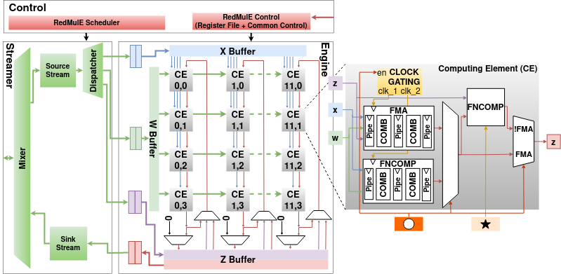
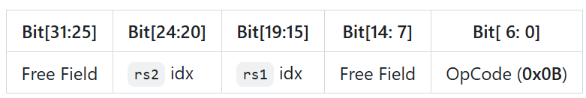
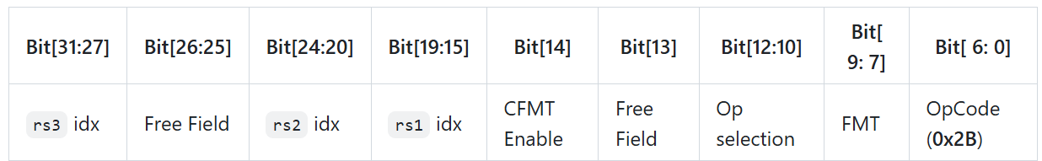
M1-WP1: Baseline Template Architecture – RedMule Engine
RedMule^{[3]} – The Tensor Engine
Developed by PULP team with open-sourced RTL
Reduced-precision matrix multiplication engine
Supporting mixed-precision floating point (FP16/FP8) arithmetic
Accelerates general matrix-matrix operations (GEMM-Ops)^{[4]}
2-Dimensional array of CEs (Compute Elements)
Systolic-like structure
RISC-V ISA extensions
mcnfig – Set GEMM M, N, K parameters
marith – Set X,W,Y matrix address + start RedMule
mcnfig Instruction
[31:0]
N size
[31:16] [15:0]
K size M size
[31:0]
Y addr
[31:0]
W addr
[31:0]
X addr
marith Instruction
[3] Tortorella, Yvan, et al. "RedMule: A mixed-precision matrix–matrix operation engine for flexible and energy-efficient on-chip linear algebra and TinyML training acceleration." Future Generation Computer Systems 149 (2023): 122-135.
[4] Zhang, Yunan, Po-An Tsai, and Hung-Wei Tseng. "SIMD2: A generalized matrix instruction set for accelerating tensor computation beyond GEMM." Proceedings of the 49th Annual International Symposium on Computer Architecture. 2022.

Slide 7
M1-WP1: Baseline Template Architecture – TE Cluster
Snitch – Tiny RISC-V Core
Single-stage, small integer control core
Instruction Cache
Shared among all cores
CTRL Registers
Used for synchronization within the cluster
Store useful information (e.g. Cluster ID)
TCDM – Multi-banked L1
Explicitly managed L1 memory
iDMA
Move data in/out of L1
RedMule – The Tensor Engine
I $
Wide Bus
CTRL
REG
Snitch
Core 0
Snitch
Core N
RedMule
iDMA
…
TCDM Interco
HWPE Interco
DMA to
TCDM
TCDM (Multi-banked L1)
Bank
0
Bank
1
Bank
2
…
Bank
M
TE Cluster

Slide 8
M1-WP1: Baseline Template Architecture – System
System Level
TE Clusters in 2D-Mesh, HBM as main memory
TE Clusters and HBM CTRL are connected by NoC
NoC enables
Cluster L1<->HBM, Cluster L1<->Cluster L1
Data NoC -- wide link, iDMA transfer bulk data
Sync NoC – narrow link, Snitch core remote access for global synchronization purpose
To Sync NoC Router
To Data NoC Router
HBM
I $
CTRL
REG
Core 0
RedMule
iDMA
R
R
R
R
Core 0
C
C
C
C
…
Core n
C
C
C
C
Interconnect
R
R
R
R
TCDM (Multi-banked L1)
HBM
HBM
C
C
C
C
R
R
R
R
TE Cluster
C
C
C
C
R
R
R
R
Data NoC Router
R
R
HBM
Sync NoC Router

Slide 9
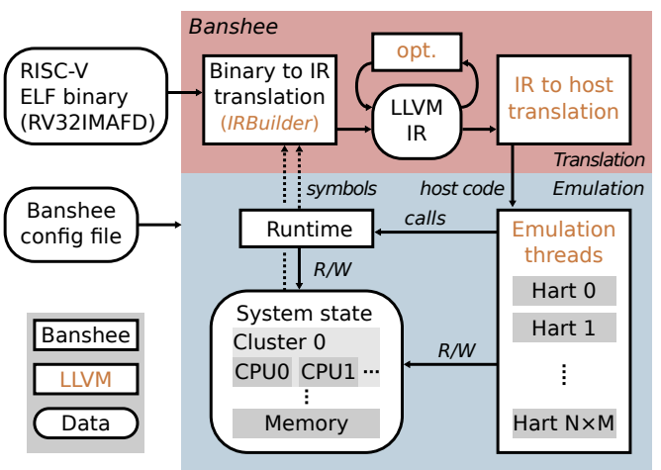
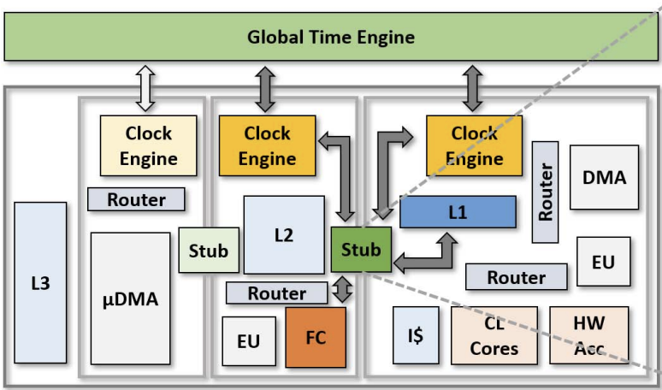
M1-WP1: High-Level Simulation Model – GVSoC Simulator
Change Plan: Banshee -> GVSoC
Banshee^{[1]} : Binary Translation Simulator
GVSoC^{[2]} : Fast and Accurate Full-Platform Simulator
Reasons
Banshee is only a functional simulator for RISCV binaries, no timing model and cannot accurately evaluate performance
GVSoC is an event-based simulator, providing accurate timing (< 10% runtime deviation vs. FPGA emulation of PULP IPs)
GVSoC is fast, achieving a simulation speed of 25 MIPS (measured with a 16-core PULP cluster)
Banshee
GVSoC
[1] Riedel, Samuel, et al. "Banshee: A fast LLVM-based RISC-V binary translator." 2021 IEEE/ACM International Conference On Computer Aided Design (ICCAD). IEEE, 2021.
[2] Bruschi, Nazareno, et al. "GVSoC: a highly configurable, fast and accurate full-platform simulator for RISC-V based IoT processors." 2021 IEEE 39th International Conference on Computer Design (ICCD). IEEE, 2021.

Slide 10

M1-WP1: High-Level Simulation Model – Integrate DRAMSys
DRAMSys5.0 (© Fraunhofer IESE):
A flexible DRAM subsystem simulator
Based on SystemC TLM-2.0, event-driven, fast simulation, JEDEC standard
Support accurate simulation of DDR4, DDR3, HBM2, HBM2E, LPDDR4
Integration with GVSoC
Synchronization of DRAMSys (SystemC) and GVSoC time engine
Interface bridge between DRAMsys and GVSoC
SystemC
Engine
SystemC Models
Synchronization
DRAM
Off-chip
On-chip
CTRL
Interface
Bridge
GVSoC
https://github.com/tukl-msd/DRAMSys
https://github.com/gvsoc/gvsoc
10
10
10

Slide 11
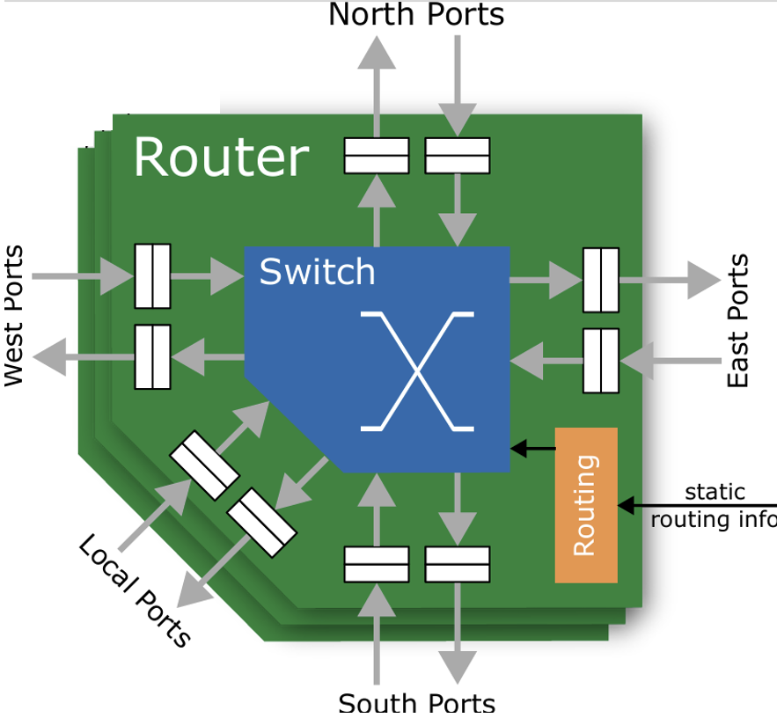
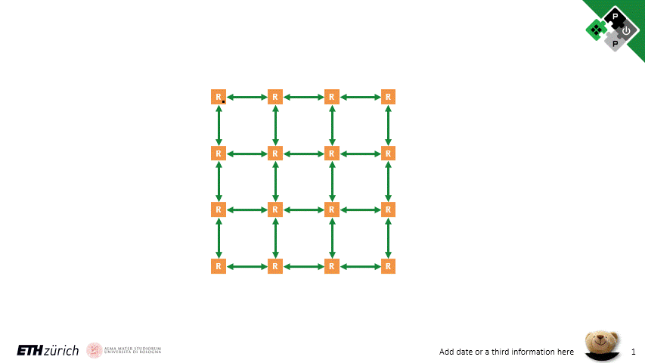
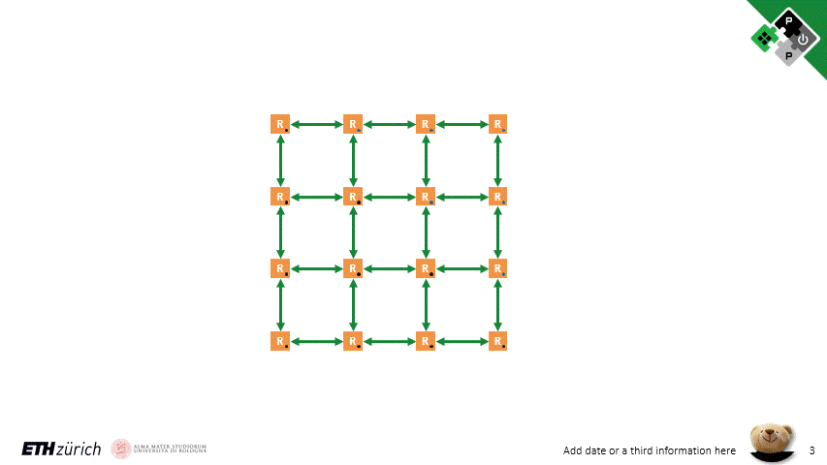

M1-WP1: High-Level Simulation Model – Develop Component
Develop Key Components in GVSoC Simulator:
RedMule – RTL Reference https://github.com/pulp-platform/redmule
iDMA – RTL Reference https://github.com/pulp-platform/iDMA
NoC – RTL Reference https://github.com/pulp-platform/FlooNoC
Model Calibration
RedMule is calibrated with RTL simulation
runtime deviation 0.17%
iDMA + NoC model calibration
3 NoC traffic patterns + static XY routing algorithm
Compare with the theoretical runtime
Generally consistent with the theoretical curve
Scatter
Dialog
Round Shift

Slide 12
M1-WP1: High-Level Simulation Model – SoftHier System
Fully Parameterizable through Configuration File:
System configuration
#Clusters (#row, #column)
NoC link data width
#HBM channels and placement on 4 edges
Cluster configuration
#Snitch cores
#TCDM banks, bank data width
Total TCDM size
RedMule CE array (height, width, CE pipeline stage)
iDMA burst length, #outstanding burst
Simulation Assumption
Cluster instruction cache are large enough and the binary are preloaded at simulation start point
To SYNC NoC Router
To DATA NoC Router
HBM
I $
CTRL
REG
Core 0
RedMule
iDMA
R
R
R
R
Core 0
C
C
C
C
…
Core n
C
C
C
C
Interconnect
R
R
R
R
TCDM (Multi-banked L1)
HBM
HBM
C
C
C
C
R
R
R
R
TE Cluster
C
C
C
C
R
R
R
R
Data NoC Router
R
R
HBM
Sync NoC Router

Slide 13

M1-WP1: High-Level Simulation Model – Open Source
Prepared Hardware Abstract Layer APIs
Cluster and core position
Cluster TCDM and HBM address calculation
Inter- and intra-cluster synchronization
iDMA and RedMule APIs
Simulator Open-Sourced on GitHub
Complete SoftHier system model
Complete software stack
Getting started tutorial
Example binaries for execution
https://github.com/gvsoc/gvsoc/tree/soft_hier_release

Slide 14
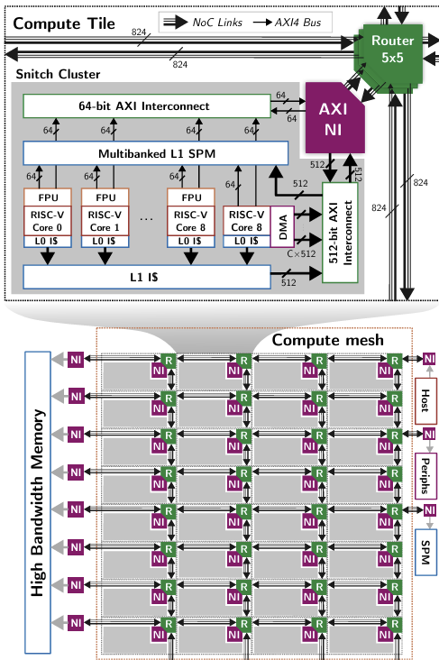
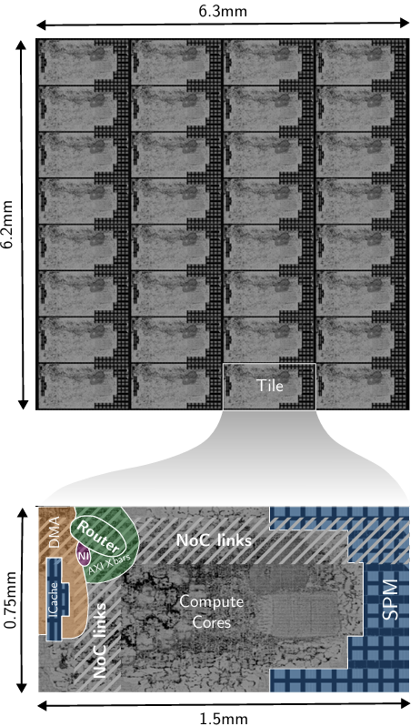
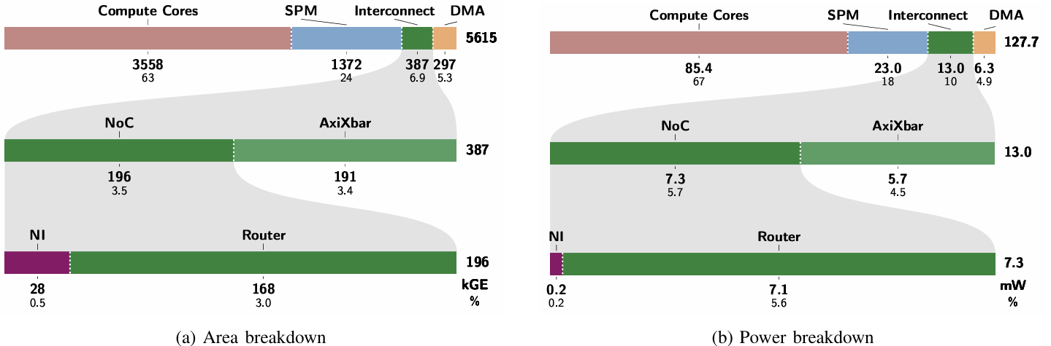
M2-WP1: PPA Estimation
Initial Synthesis and PnR Trial
Thanks to Tim's and Thomas's work on a reduced RTL version of the SoftHier system
RedMule is not included, focusing on the area and power of iDMA and NoC
Synthesis and PnR in GLOBALFOUNDRIES’ 12nm FinFET technology, at the typical corner (0.8V, 25°C)
NoC router with narrow 64b + wide 512b link data width
Timing: SoC frequency of 1.14 GHz reached
iDMA per cluster
Area: 297 kGE (5.3%), Power: 6.3 mW (4.9%)
NoC router per cluster
Area: 196 kGE (3.5%), Power: 7.3 mW (5.7%)

Slide 15
First-Year Milestones Reached
M1-WP1: The Banshee GVSoC open-source simulator will be enhanced to support tensor operators and KiloPE tensor units as well as multiple TEs. Baseline performance models will be added. This simulator will be released to WP2 to help SW development and performance estimation
M2-WP1: A first set of synthesis trials will be run on DMAs and interconnects to estimate cost and performance of the first version of hardware and provide the key components for system-level PPA assessment

Slide 16
Looking forward to Second-Year Work Package
Architectural Optimization, Tuning, and Microkernels Benchmarking (M3-WP1)
The data motion engines, the interconnect, and memory endpoints will be tuned and optimized to facilitate programing and boost performance.
The proposed hardware enhancements will be prototyped, and their performance benefits will be assessed with microkernels
Hardware costs of the enhancements will be closely monitored to ensure that efficiency remains highly competitive with cache-based techniques, both in terms of system performance and energy efficiency.
Benchmarking on hardware-software integration between the two WPs (M4-WP1-WP2)
Demonstrating targeted transformations to optimize and streamline performance for CLOUDSC cloud microphysics scheme and the LULESH hydrodynamics solver as well as ML applications.
Detailed performance study with different application configurations and comparing various workflow options. For Ascend, we will aim at mapping Deep Learning kernels such as Transformer Decoders.
Open-source release hardware RTL, new version of high-level simulator, software tools and benchmark applications
[1] Riedel, Samuel, et al. "Banshee: A fast LLVM-based RISC-V binary translator." 2021 IEEE/ACM International Conference On Computer Aided Design (ICCAD). IEEE, 2021.

Slide 17
Run Ahead into M3-WP1-- GEMM Dataflow Mapping
No Inter-Cluster L1 Communication
Each clusters take care of different output tiles.
iDMA transfers input matrix tile + weight matrix tile from HBM
No inter-cluster tile reuses
Input
Input
Cluster₀₀
R
R
Cluster₀₁
R
Cluster₀₂
R
Cluster₀₃
Weight
R
R
R
R
Cluster₁₀
Cluster₁₁
Cluster₁₂
Cluster₁₃
HBM
R
R
R
R
Cluster₂₀
Cluster₂₁
Cluster₂₂
Cluster₂₃
Output
R
R
R
R
Cluster₃₀
Cluster₃₁
Cluster₃₂
Cluster₃₃

Slide 18
Run Ahead into M3-WP1 -- GEMM Dataflow Mapping
Leverage Inter-Cluster L1 Communication
Reuse tiles, reduce HBM accesses, save BW limitation
Need “smart” tile mapping and scheduling
Input
I₀₀
I₀₁
I₀₂
I₀₃
Weight
W₀₀
W₀₁
W₀₂
W₀₃
I₁₀
I₁₁
I₁₂
I₁₃
W₁₀
W₁₁
W₁₂
W₁₃
Cluster₀₀
W₂₀
W₂₁
W₂₂
W₂₃
R
R
Cluster₀₁
R
Cluster₀₂
R
Cluster₀₃
I₂₀
I₂₁
I₂₂
I₂₃
I₃₀
I₃₁
I₃₂
I₃₃
W₃₀
W₃₁
W₃₂
W₃₃
R
R
R
R
Cluster₁₀
Cluster₁₁
Cluster₁₂
Cluster₁₃
HBM
R
R
R
R
Cluster₂₀
Cluster₂₁
Cluster₂₂
Cluster₂₃
O₀₀
O₀₁
O₀₂
O₀₃
Output
O₁₀
O₁₁
O₁₂
O₁₃
R
R
R
R
O₂₀
O₂₁
O₂₂
O₂₃
Cluster₃₀
Cluster₃₁
Cluster₃₂
Cluster₃₃
O₃₀
O₃₁
O₃₂
O₃₃

Slide 19
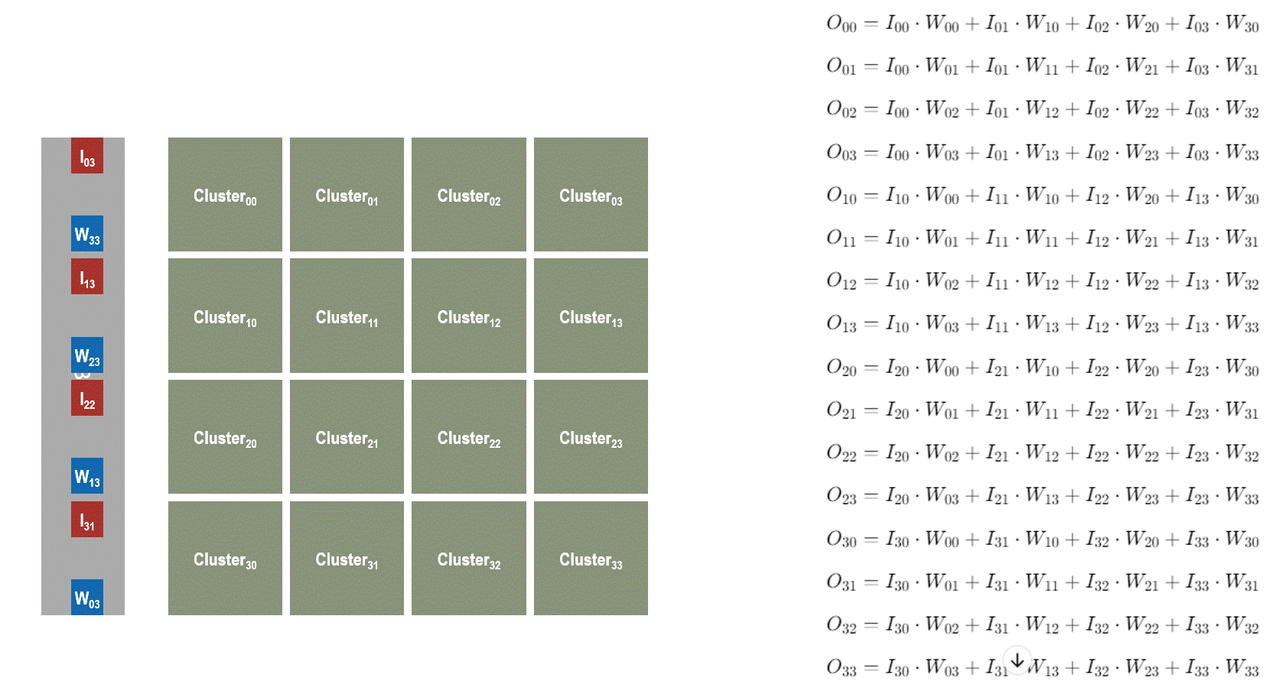
Run Ahead into M3-WP1 -- GEMM Dataflow Mapping
An example solution of inter-cluster dataflow for large GEMM.

Slide 20
Run Ahead into M3-WP1 -- GEMM Dataflow Mapping
Benchmark GEMM
16384 x 16384 x 16384
GEMM data type = FP16
8 TFLOPs RedMule per cluster
NoC link data width = 1024b
Scale-out SoftHier System
4x4 Clusters + 16 HBM2E channels
8x8 Clusters + 32 HBM2E channels
16x16 Clusters + 64 HBM2E channels
2048 TFLOPS @FP16
3.2 TB/s HBM BW
Key Results: Enabling cluster-to-cluster comm is scalable, which reduces off-chip traffic and no need to increase L1 size for better compute utilization when scaling out
TCDM Size in Cluster:
Max Tile Dimension: 32 64 128 256 512 1024

Slide 21
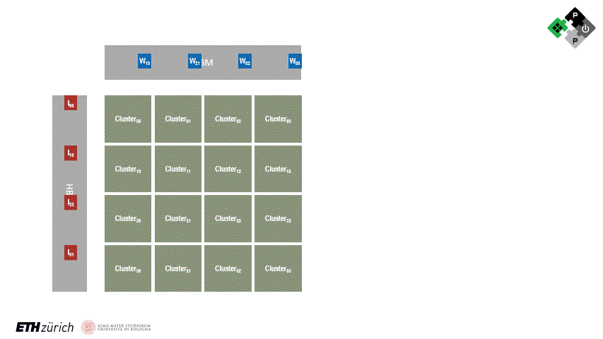

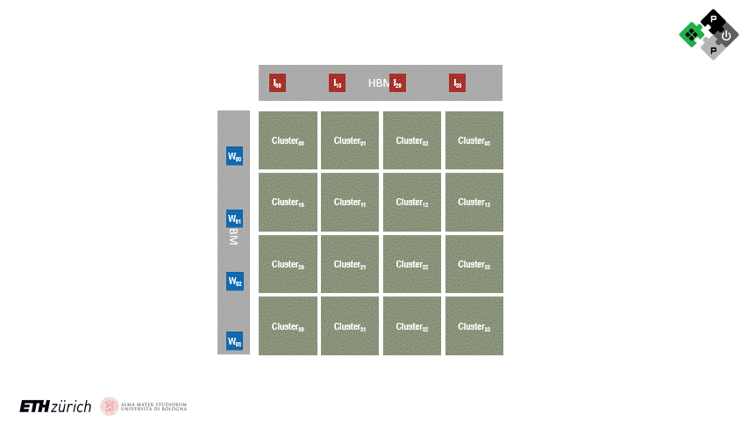
Run Ahead into M3-WP1 -- GEMM Dataflow Mapping
1
Explore More GEMM Dataflow
1. On-chip shuffling – double buffering {compute, on-chip transfer}
2. On-chip shuffling – triple buffering {compute, on-chip transfer, off-chip transfer}
3. Systolic-wise streaming – double buffering {compute, neighbor node transfer}
Benchmark GEMM
16384 x 16384 x 16384
GEMM data type = FP16
8 TFLOPs RedMule, 1MB L1 per Cluster
8x8 Clusters + 32 HBM2E channels
Result
Systolic streaming is better
Require narrower NoC link data width
2
3

Slide 22
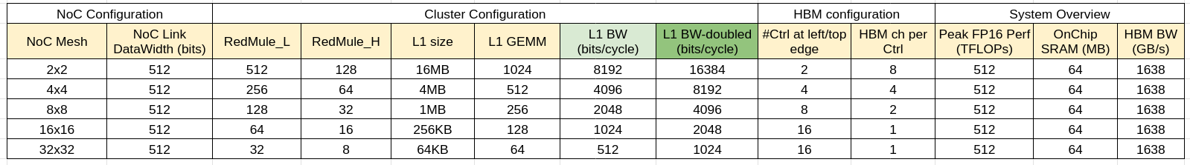
Run Ahead into M3-WP1 -- Architecture Design Exploration
Many Clusters with Small RedMule vs. Few Clusters with Big RedMule
Invariant Parameters During SoftHier System Transformation:
Total compute power
Total L1 area budget
NoC link width
Total HBM BW
C
C
C
C
RM
RM
RM
RM
C
RM
C
RM
C
RM
C
RM
C
RM
C
RM
C
RM
C
RM
C
C
C
C
C
C
C
C
RM
RM
RM
RM
RM
RM
RM
RM
C
C
C
C
C
C
C
C
C
C
C
C
RM
RM
RM
RM
RM
RM
RM
RM
RM
RM
RM
RM
C
C
C
C
C
C
C
C
RM
RM
RM
RM
RM
RM
RM
RM
C
RM
C
RM
C
RM
C
RM
C
RM
C
RM
C
RM
C
C
C
C
C
RM
RM
RM
RM
RM
C
RM
C
RM
C
RM
C
RM
C
RM
C
RM
C
RM
C
RM
C
RM
C
RM
C
RM
C
RM
C
RM
C
RM
C
RM
C
C
C
C
C
RM
RM
RM
RM
RM
C
RM
C
RM
C
RM
C
RM
C
RM
C
RM
C
RM
C
RM

Slide 23
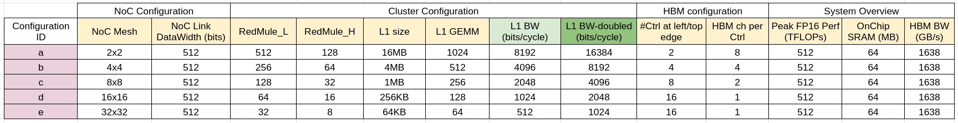
Run Ahead into M3-WP1 -- Architecture Design Exploration
Benchmark GEMM
16384 x 16384 x 16384
Systolic-like inter-cluster tile stream
Result
Few clusters with big RedMule
Limited by NoC BW (if it can not scale)
Other potential limitations
RedMule may not scale
L1 TCDM BW may not scale
Less flexible for application with small GEMM
Many clusters with small RedMule
Small L1-> Shorter GEMM steps -> More sync needed
Many cluster -> Each sync costs more time
NoC BW-bound
Sync-bound

Slide 24
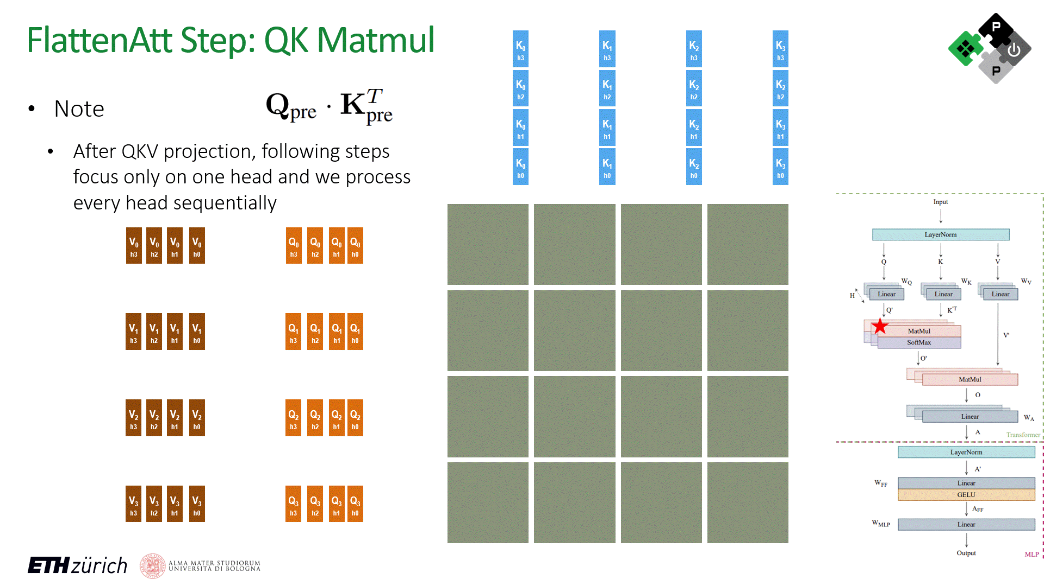
Run Ahead into M3-WP1 -- Multi-Head Attention Mapping
Proposed Dataflow Schedule of MHA on SoftHier (FlattenAttention)
We leverage all-cluster L1 for single head attention – Minimize I/O complexity
We introduce performance model of specific accelerators in each cluster to complete MHA
Vector engine for SoftMax operations (max(V), sum(V), sub(V,s), exp(V), div(V,a))
Matrix transpose engine for transposition of (K -> K^{T})
Virtually enable collective operations on NoC -- estimate runtime for NoC collective operations
Benchmark & Results
16x16 Clusters(8TFLOPS, 256kB L1), 2TB/s HBM
One layer MHA of Llama3-70B (seq=4K, batch=8)
Efficient collective operation support on NoC is essential
3x speedup to baseline
Total Runtime(ms)
Baseline: Flash Attention for Each Head on Each Cluster | 14.4
Flatten Attention (w/o NoC collective) | 17.7
Flatten Attention (w/ NoC collective) | 4.6

Slide 25
Looking Forward – Exploration Directions
HW Enhancement
NoC collective operation support solutions (RTL + GVSoC)
Enable iDMA for on-the-fly matrix transposition
Tracking the HW Cost
Setting up area and timing models for key components: RedMule, iDMA, FlooNoC
Design Space Exploration (LLM-Oriented)
A template code for end-to-end LLM inference/training workload
Architecture design space exploration for the SoftHier system
Finding the optimal configuration for a set of LLM model and workloads

